Slide 1

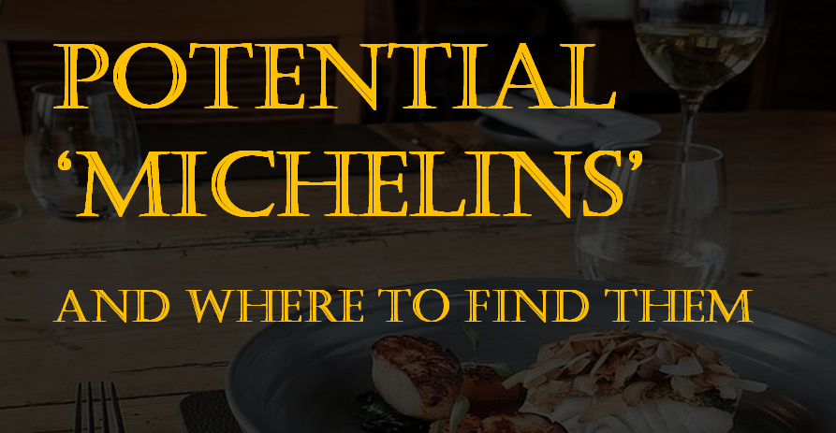

Team Spyder : Chenjian Yang, Shenghui Hua, Yining Li

Slide 2

01
Preview & Preprocessing
• Overview • Web Scraping • Data Cleaning
02
Data Exploratory
• Category • Stars • Rating & Reviews
OVERVIEW
03
Text Analyses
• Sentiment Analysis • Similarity
• Topic Analysis
04
Machine Learning
• Classification • OLS

Slide 3
01
Preview & Preprocessing
• Overview • Web Scraping • Data Cleaning
OVERVIEW

Slide 4
01 Preview & Preprocessing
Overview Web Scraping Data Cleaning
Bread is the staff of life!
The Michelin Restaurant/ The Red Michelin Guide
Highest reward to restaurant
Fine dining/ Art like dishes with high quality
Good service
Hard to reserve/ Expensive
Find non-Michelin Restaurants with Michelin quality (with Yelp data)
How does Michelin Restaurant profile look like in Yelp?
How is it different from non-Michelin profile?
Can Yelp data help us predict Michelin Restaurants/Stars?

Slide 5
01 Preview & Preprocessing
Overview Web Scraping Data Cleaning
API and Web scraping
Collect Michelin restaurants in: New York, Chicago, San Francisco, Washington
Get 4000 restaurants Infos from these 4 cities via Yelp API
Get 100 reviews per restaurant via Yelp scraping, totally 350,000+ Reviews

Slide 6
01 Preview & Preprocessing
Overview Web Scraping Data Cleaning
Data Cleaning
Remove restaurants contain NaN in important variables (eg: price, reviews)
Create dummy features for Logical variables (eg. Deliver: 0 for no and 1 for yes)
Ultimate Form: Final Restaurant Number: 3800+
Yelp Data | name, rating, review count, url, reviews, delivery, pickup, reservation
Location | latitude, longitude
Price(dummy) | price1-$, price2-$$, price3-$$$, price4-$$$$
City(dummy) | New York, Chicago, Washington, San Francisco
Categories (dummy) | French, American , Korean, Italian, Thai, American, Chinese, Japanese, Mediterranean, Spanish, Mexican, Indian, British, Seafood, Wine Bars, Steakhouses, Dim Sum

Slide 7
02
Data Exploratory
• Category • Stars • Rating & Reviews
OVERVIEW

Slide 8
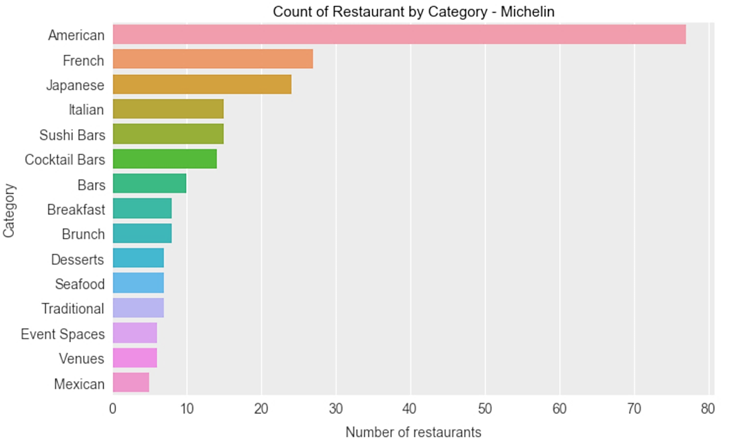
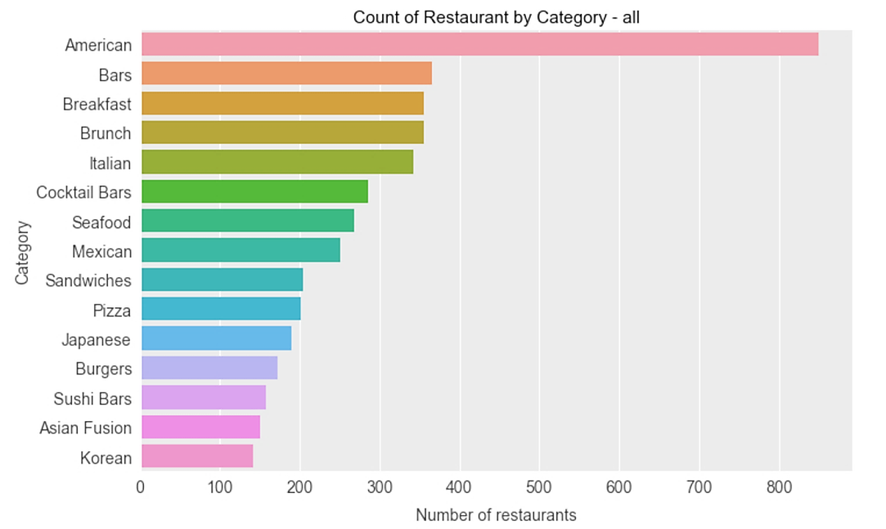
02 Data Exploratory
Categories Stars Rating & Reviews

Slide 9
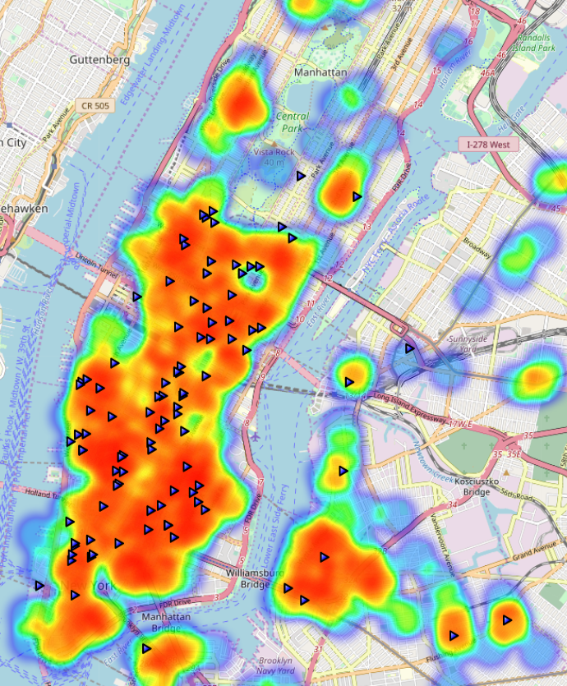
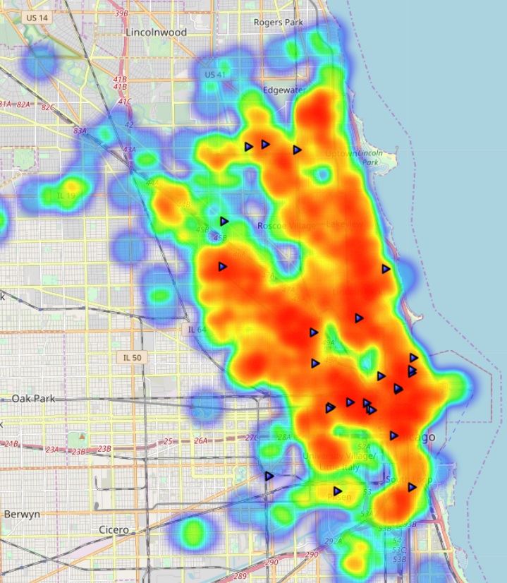
NYC
Chicago

Slide 10
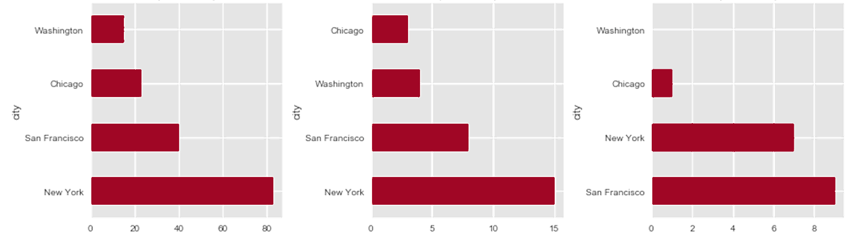

02 Data Exploratory
Categories Stars Rating & Reviews

Slide 11
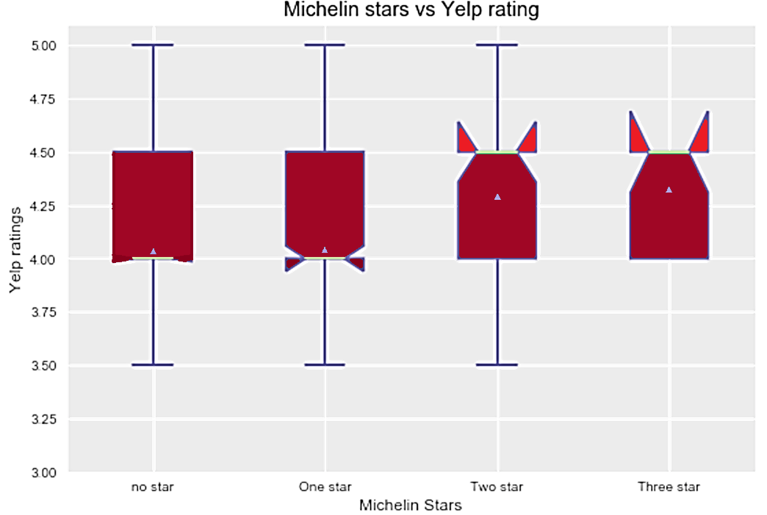
02 Data Exploratory
Category Stars Rating & Reviews
No star: 4.03
1 star: 4.09
2 star: 4.28
star: 4.32
Weighted average
Typical Michelin yelp rating = 4.14

Slide 12
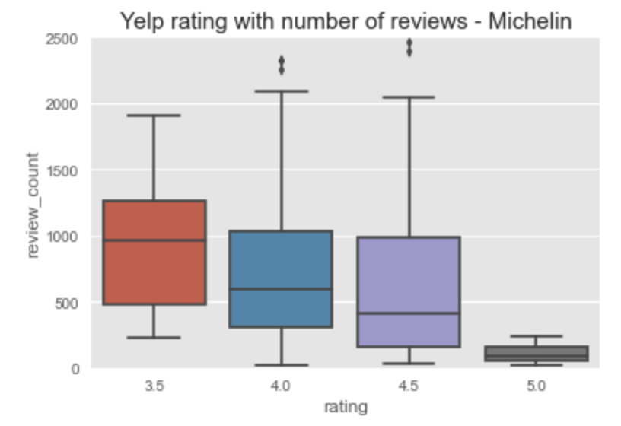
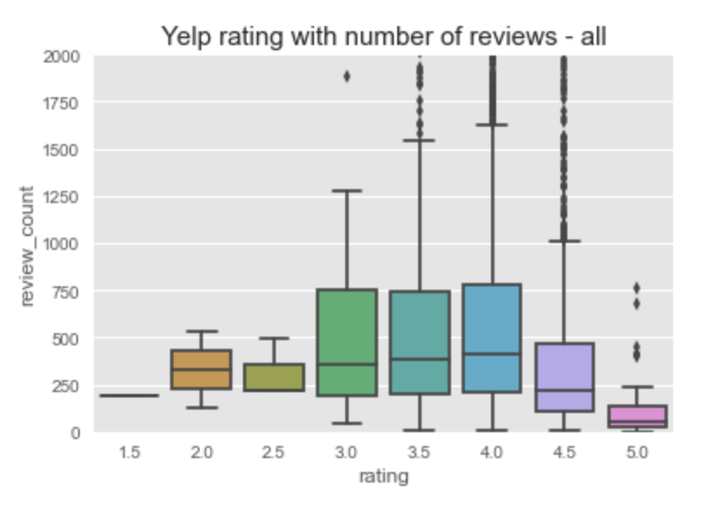
02 Data Exploratory
Categories Stars Rating & Reviews
Weighted average： Typical Michelin review number = 736

Slide 13
OVERVIEW
03
Text Analyses
• Sentiment Analysis • Similarity
• Topic Analysis

Slide 14
03 Text Analysis
Sentiment Analysis
Similarity
Topic Analysis
We want to figure out if there are differences of review contents between Michelin and Non-Michelin restaurants —— Sentiment Analysis and LSI
For the bulk of reviews associated with each restaurant
We calculated the two set of scores to get a sense of the general sentiment:
Sentiment scores:
Vader | Positive, negative, compound, neutral positive – negative (have polarity)
NRC | positive, negative, positive – negative surprise, trust, anticipation, joy sadness, anger, disgust, fear

Slide 15
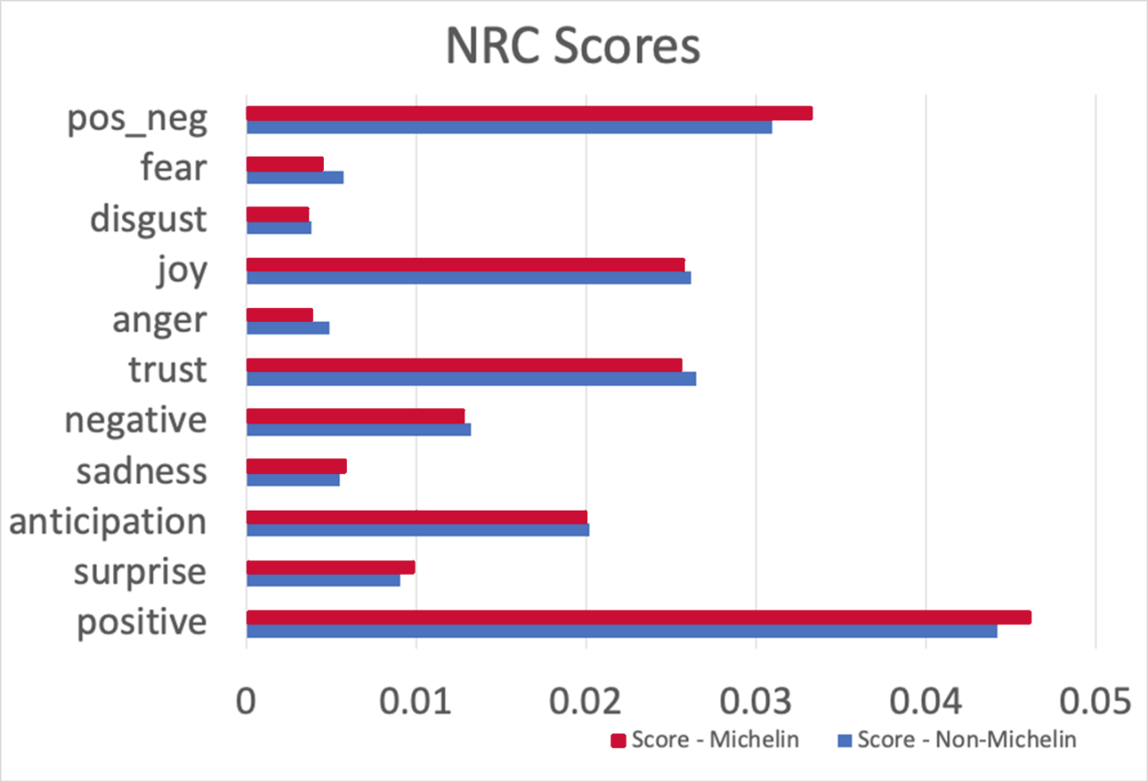
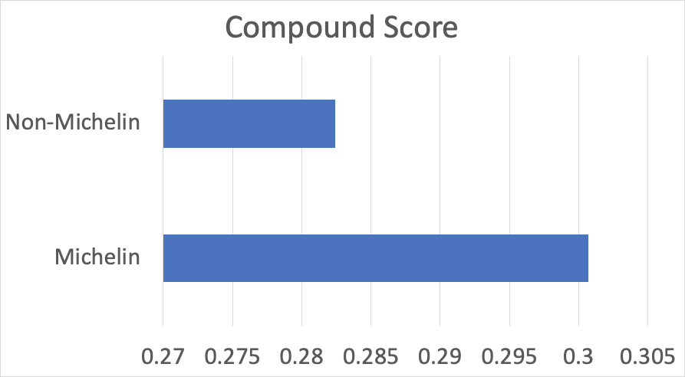
03 Text Analysis
Sentiment Analysis
Similarity
Topic Analysis

Slide 16
03 Text Analysis
Sentiment Analysis
Similarity
Topic Analysis
We used LSI Model to compare similarities
01 For each restaurant: Calculate the similarity with Michelin restaurants
For each Non_Mi restaurant:
Find its Top 50 most similar Michelin Restaurants
Calculate the Avg. Similarity score
For each Michelin restaurant:
Find its Top 50 most similar Michelin Restaurants except itself
Calculate the Avg. Similarity score (named ‘sims_score’ in code)
Each restaurant review
Michelin
reviews corpus
Higher ‘sims_score’:
Restaurant review is more similar with Michelins
Maybe more likely to be a Michelin one
Notes:
For each rest， compare its review doc with the Michelin corpus， find top 50

Slide 17
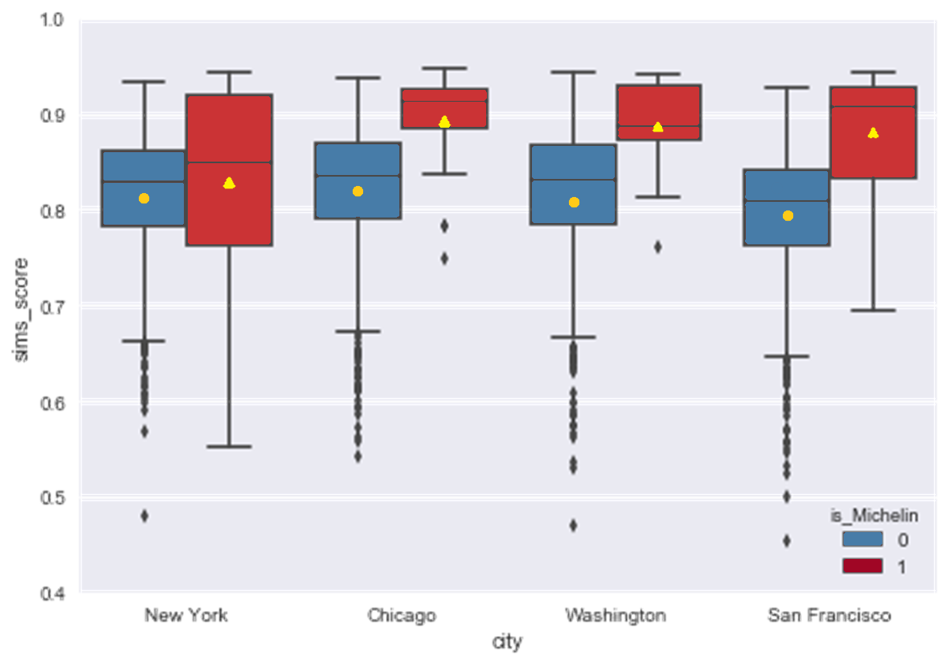

Slide 18
03 Text Analysis
Sentiment Analysis
Similarity
Topic Analysis
02 For each Michelin restaurant: Find its Top 100 most similar restaurants
——— “ Top 100 list ”
Calculate the frequency of all the restaurants appeared in these lists.
(save the scaled frequency as ‘appear_time_score’)
Higher ‘appear_time_score’ → More likely to be a Michelin one
Each Michelin review
All restaurants
reviews corpus
Top 100
Similar lists
How many times each rest. appears in these lists
Notes:
In the previous part, for each Mi we compare its review doc with michelin corpus,
Now for each mi, we compare its review doc with all restaurants corpus, and still find the top 50 most similar ones,
Since we use all restaurants corpus, these top 100 can either be mi or non_mi.
We calculate the frequency of all the rests appeared in the top 100 lists, and use the scaled frequency as an another score.

Slide 19
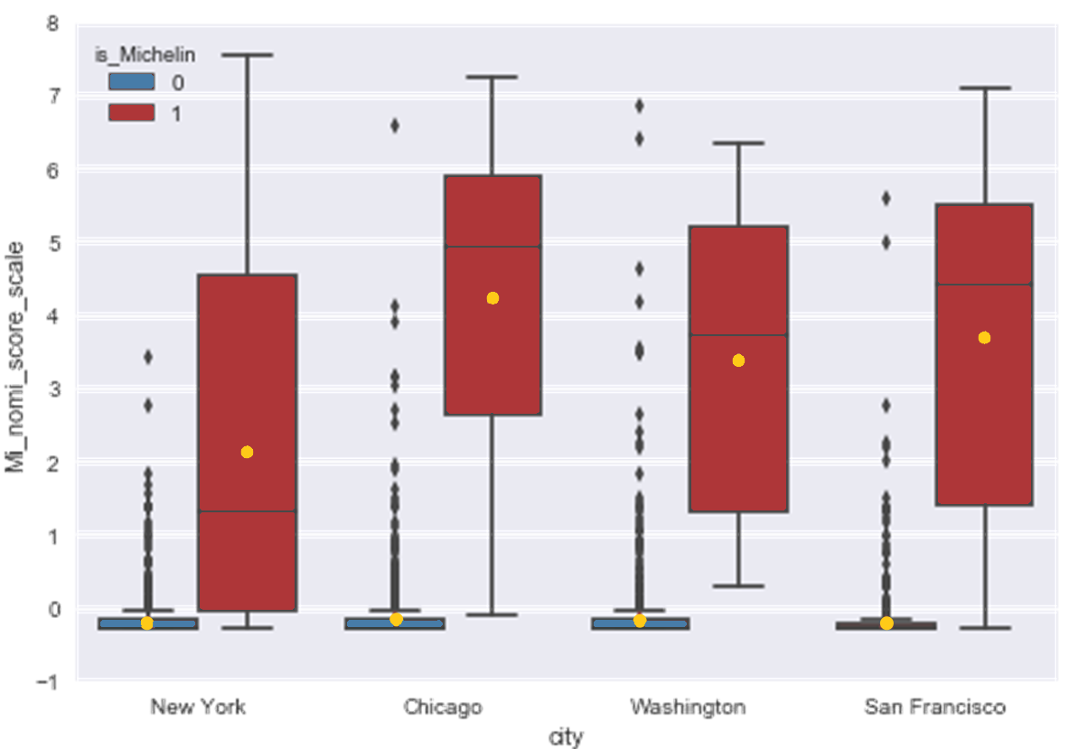

Slide 20
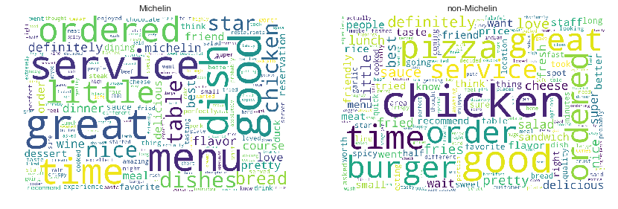
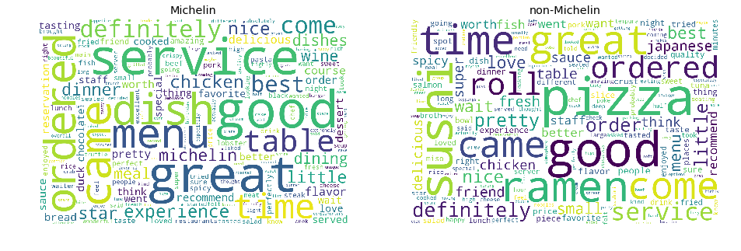
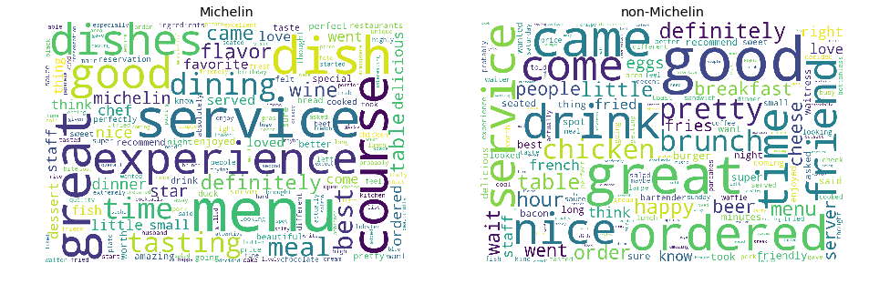
03 Text Analysis
Sentiment Analysis
Similarity
Topic Analysis
Now that we know reviews have some differences
What are the differences? —— LDA
Michelin
Non-Michelin
Notes:
LDA for Michelin reviews and Non-Michelin reviews
Mi: polarity words 'definitely', 'menu', 'course/dish', 'service', 'experience' —> decent
non-Mi: more specific styles, 'time', 'brunch', 'friend' —> casual
pyLDAvis—general result

Slide 21
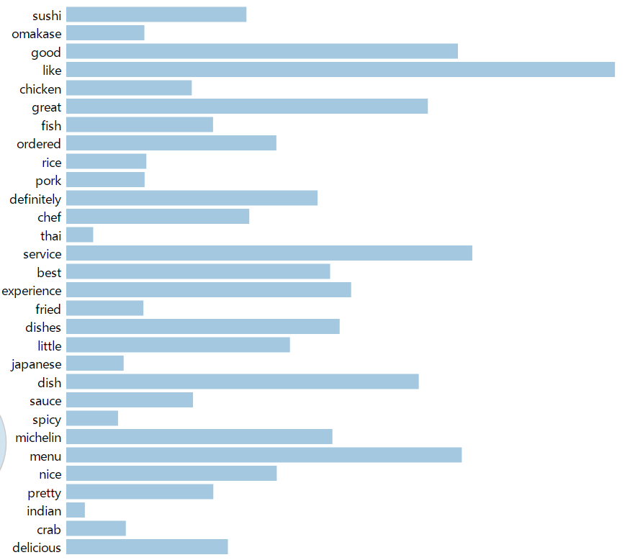
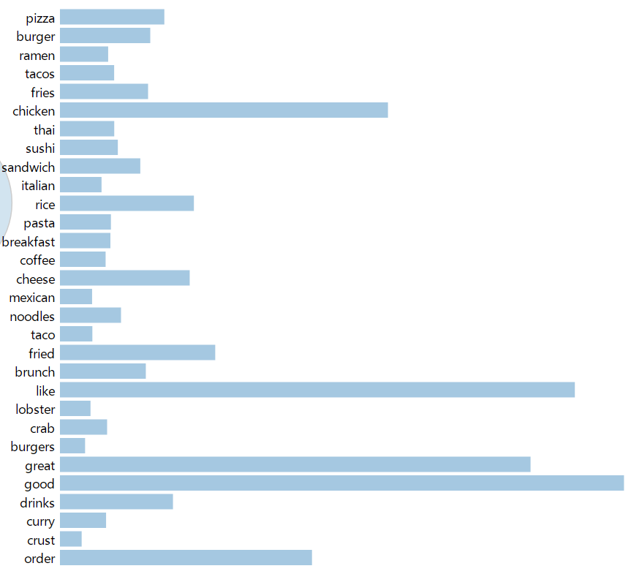
Michelin
Non-Michelin

Slide 22
OVERVIEW
04
Machine Learning
• Classification • OLS • Factor Analysis

Slide 23
04 Machine Learning
Classification
OLS
Data Preprocessing —— Created dummy variables for:
Categories: [ ‘French’, ‘American’, ‘Chinese’, ‘Mediterranean’, ‘Seafood’, ...]
Four cities, Four price levels, Delivery, Pickup, Reservation
Dataset for classification consisted of the following columns:
Yelp Data |  | Rating, review count, delivery, pickup, reservation city dummies, category dummies, price dummies
Sentiment | Vader | positive, negative, net, neutral, compound
 | NRC | positive, negative, net, surprise, sadness anticipation, trust, anger, joy, disgust, fear

Slide 24
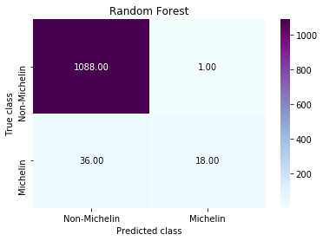
Random Forest
Relative feature importance
vader_negative | 2.13% | vader_pos_neg | 4.29%
NRC_joy | 2.38% | neutral | 4.44%
NRC_pos_neg | 3.06% | vader_positive | 4.66%
NRC_anticipation | 3.14% | NRC_sadness | 4.74%
NRC_negative | 3.43% | NRC_surprise | 4.76%
NRC_fear | 3.95% | review_count | 4.88%
NRC_trust | 4.00% | NRC_anger | 5.01%
NRC_disgust | 4.10% | compound | 6.07%
NRC_positive | 4.21% | price4 | 30.73%
Precision: 0.95 identified as Michelin are Michelin
Recall/TPR: 0.33 proportion of Michelin identified
False Positive Rate: 0.00 proportion of Non-Michelin identified as Michelin
f-score: 0.64 tradeoff between precision and recall
Accuracy: 0.97 how well the model has classified

Slide 25

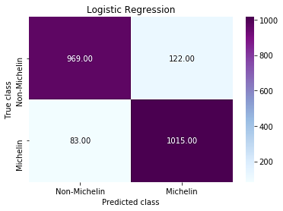
Logistic Regression
With ADASYN
Precision: 0.77 0.89 identified as Michelin are Michelin
Recall/TPR: 0.50 0.92 proportion of Michelin identified
False Positive Rate: 0.01 0.11 of Non-Michelin identified as Michelin
f-score: 0.63 0.63 tradeoff between precision and recall
Accuracy: 0.97 0.91 how well the model has classified

Slide 26
04 Machine Learning
Classification
OLS
 | coef | std err | t | P>|t| | [0.025 | 0.975]
const | -4.9449 | 0.293 | -16.889 | 0.000 | -5.519 | -4.317
Pickup | -0.0452 | 0.006 | -7.147 | 0.000 | -0.058 | -0.033
vader_negative | 0.0759 | 0.007 | 10.979 | 0.000 | 0.062 | 0.089
vader_compound | 0.0253 | 0.002 | 13.817 | 0.000 | 0.022 | 0.029
vader_neutral | 0.0495 | 0.003 | 17.042 | 0.000 | 0.044 | 0.055
NRC_positive | 0.0403 | 0.007 | -5.610 | 0.000 | 0.026 | 0.054

Slide 27
Conclusions and Recommendations
Conclusions
Recommendations
We were able to derive a list of Michelin-like restaurants based on our calculation of similarity scores [‘appera_time_score’]
Overall, publicity and customer experience do seem to be the differentiating factors for being a Michelin restaurant. The effect of number of reviews and several sentiment scores do seem to crowd out categories, ratings, and price across several models;
Despite high accuracy, classification models based on Yelp data have very low recall due to imbalanced dataset:
Most significant factors from the OLS model match our expectations (eg. sentiment scores)
With over-sampling, we were able to achieve higher recall in logistic regression

Slide 28
Conclusions and Recommendations
Conclusions
Recommendations
Everyone is critical
Yelp reviewers are from different background with preference emphasize on some factors
price, serve amount, etc.
Possible Improvements
Classify reviews with Elite and normal
Get the years of the review
More depth (restaurant and reviews) in just one city

Slide 29

Conclusions and Recommendations
Conclusions
Recommendations
New York
Washington
San Francisco
Chicago
Kura
Traif
Olmsted
Manhatta
The Eddy
Sushi By M
Boulud Sud
Henry's End
DOMODOMO
Sushi by Bou Times Square
Homestead on the Roof
Mercat a la Planxa
TWO Restaurant
Les Nomades
Home Bistro
Lion Heart
Bellemore
the Albert
Arbor
Eden
Marcel's by Robert Wiedmaier
Elizabeth's Gone Raw
A Rake's Progress
1789 Restaurant
Honeysuckle
Le Desales
Corduroy
Gravitas
Del Mar
Obelisk
Pappo
Utzutzu
Duende
Hanazen
The Wolf
Homestead
Chez Panisse
Juanita & Maude
Rivoli Restaurant
Julia's Restaurant

Slide 30

Thanks

